Slide 1
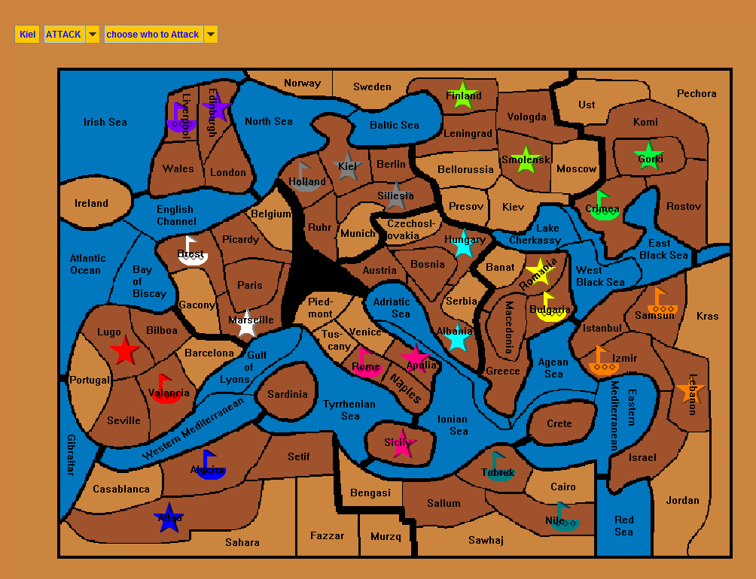
Diplomacy
Hugh McGough
Description
This is a board game that focuses on skill and diplomacy rather than luck or brute force. There are a total of twelve teams scrambling for total domination, in order to come out on top teams need to form coalitions with each other. But in the scramble for total domination who can you trust? Forming a coalition with others could leave you vulnerable to your “allies” if they choose to double cross you.
Features of this game include a no luck based combat system where you need more man power than who you are attacking, with only one unit allowed per territory positioning is key in this game, with only a bank of 50 units available to share between the 12 teams, it becomes quickly apparent that teams need to work together to overpower their opponents. All turns are taken simultaneously in order to maximize the element of surprise and to maximize the simplicity of teamwork in this game.
Target Users
Students
Teachers
Friends (that don’t want to be friends anymore ;)
People that like strategy games like chess
How this helps the target user:
This game closely models the strategy and diplomacy that took place during World War 1, this game has been played in history classes before and this program would only expedite the process of playing this game for teachers and students. Traditionally the teacher would take all of the orders of the 40 to 50 units and manually labor through all of the commands and resolve them one by one. This process can take 10 minutes or more; if you do the math, students only get 4 to 5 turns per class period. With so few turns taken per day and only a few days to spend on this game in class, few games usually end with one team as the victor. The aid of a computer program would instantly resolve all of the commands and display them all in a simple and clean style, thus optimizing the classroom experience, and time taken to play this game. The simple input system would also optimize peoples’ use of their turn to reduce invalid commands being entered which does happen more than you would think.
People who like strategy games would easily love this game and with 12 teams it would be easy to use this as a platform to meet other people. But be wary, because this game is world famous for ruining peoples friendships with a single backstab.
WORK PROCESS
Description DSA FASL

